Slide 1

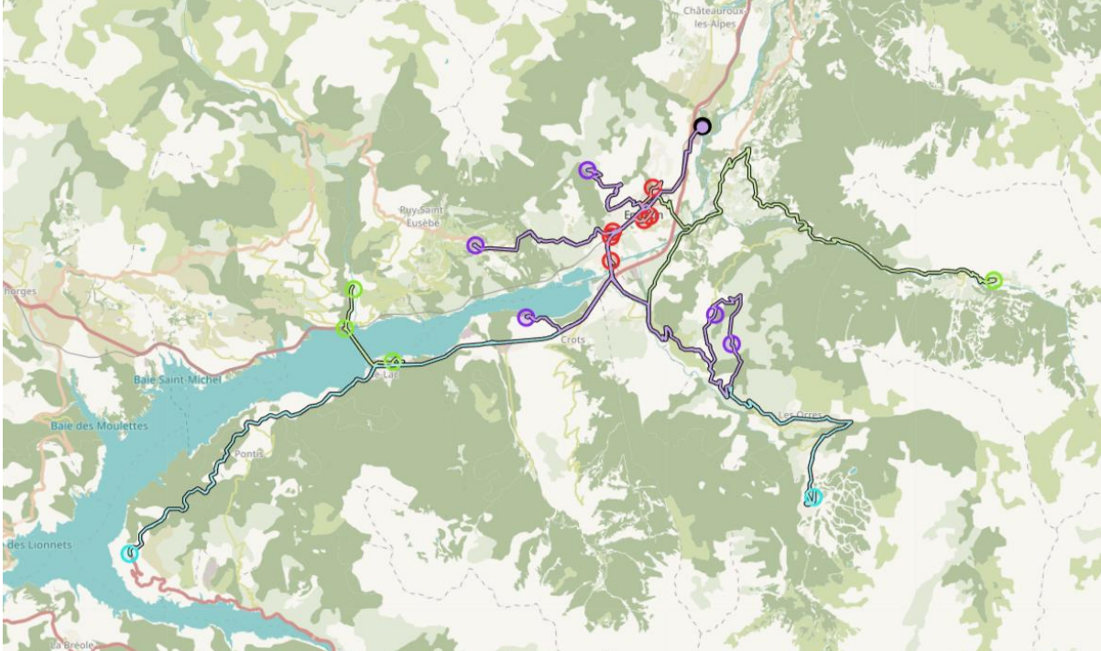
Forecast and Forecast based clustering for waste collection sites in Serre Ponçon
Transport Logistics and Operation
Research - Project 1 Génie Industriel
Project members:
Sara Bayzan
Aboubaker Al Kadiri
Harihareshwar Kumaravel
Mohamed Flaity
Felix Brecht
Albin Tamewe

Slide 2
CONTENT
Introduction
Problem Description
Methodology
Limitations
Results
Conclusion

Slide 3
Introduction
Serre-Poncon lake a large artificial lake in France
4 types of waste
328 pick-up sites of waste
more than 1000 containers
6 garbage trucks
has a very high seasonality due to its touristic location
Disposal site center (Embrun)
one main road to reach
only one for all the collection sites
Hardly any tools available to optimize the garbage collecting process!

Slide 4
Problem Description
Two Major Questions:
1) What containers should be collected and at what date?
2) What are the sites clustered for a given period depending on that demand to increase effectiveness?
Proposal of three Tools/Methods
1) Demand Forecasting (RMSE for choosing between Exponential smoothing, Autoregressive method, ARIMA,
ARMA & SARIMA)
2) Clustering (k-means)
3) Routing (enums_pb2)

Slide 5
DATA INPUTS
Historical Filling rates of containers
Spreadsheets with Columns
Date
Commune
Points CARTON*
Taux
Distances
JSON file with Distance Matrix
*-Different based on waste type

Slide 6
DATA CLEANING
Column Names
Column Names – Before Cleaning | Column Name – After cleaning
Date | date
Commune | commune
Points CARTON* or N° point | n_point
Taux | taux
Column datatypes
date | datetime64[ns]
commune | str
n_point | str
taux | float64
* differs based on waste type

Slide 7
TIME SERIES FORECASTING MODELS
Exponential Smoothing(α)
Auto Regressive Model (p,0,0)
Autoregressive Moving Average (ARMA) Model (p,0,q)
Autoregressive Integrated Moving average(ARIMA) model (p,d,q)
Seasonal Autoregressive Integrated Moving average(SARIMA) model ((p,d,q)(P,D,Q)m )

Slide 8
METHODOLOGY FOR FORECASTING
Select the data frame from cleaned data based on user inputs – n_point and type of waste
Split the selected data frame into a training set and a test set. (80% as Train data and 20% as Test data)
Fit the following 5 time series forecasting models to the training set:
Exponential Smoothing
Autoregressive model
Autoregressive Moving Average model
ARIMA model
SARIMA model
For each model, Use the fitted model to make predictions on the testing set and calculate the RMSE by comparing the predicted values to the actual values in the test set.
Select the model with the lowest RMSE.
Use the selected model to make future predictions on new data.

Slide 9
METHODOLOGY FOR CLUSTERING
Before Clustering
Forecasting script is looped for every locations & waste types
The output of this is stored in a spreadsheet.
Clustering
Select the points from above spreadsheet based on user input - ‘date’ and ‘waste type’
Select the optimum number of clusters based on ‘Elbow Method’ by plotting WCSSE and clusters ‘k’
Use that optimum ‘k’ to cluster the locations based on ‘distance’ and ‘predicted fill rate’ into k cluster

Slide 10
METHODOLOGY FOR ROUTING
The output of the clustering algorithm is used as the input here.
Make a distance matrix for each clustered locations from the Distances file.
Use a Python library, such as Pulp, Pyomo, Gurobi, or Google OR Tools to solve the VRP.
Check that the solution is feasible and meets the constraints of the VRP, such as ensuring all locations are visited.
Create a plan for each vehicle's route and provide instructions for the drivers. This may involve creating a map of the routes.

Slide 11
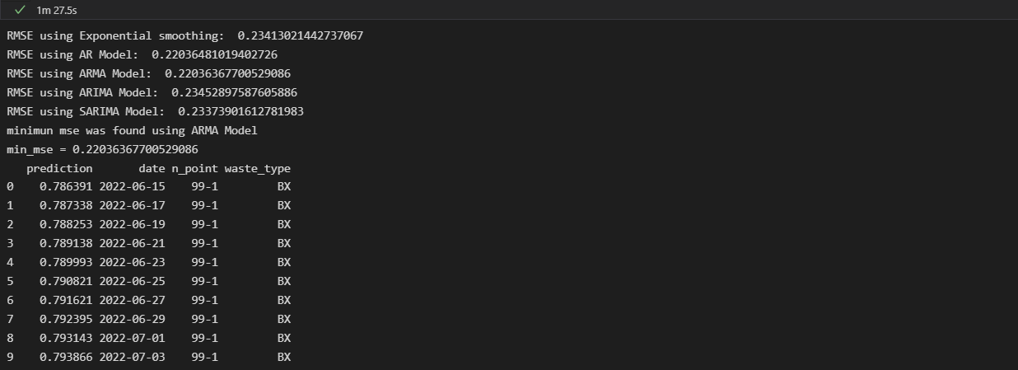
Forecast Results
Prediction example of fill rate at location (99-1) & waste type BX
Results of the script execution

Slide 12
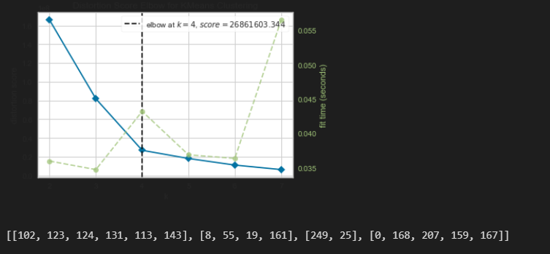
Clustering Results
the User Inputs the type of waste and date on which the clustering has to be made
The graph shows the optimum number of clusters found using the elbow method by the ‘KElbowVisualizer’ class. Here, k = 4 and the clusters of cities are [[102, 123, 124, 131, 113, 143], [8, 55, 19, 161], [249, 25], [0, 168, 207, 159, 167]].

Slide 13
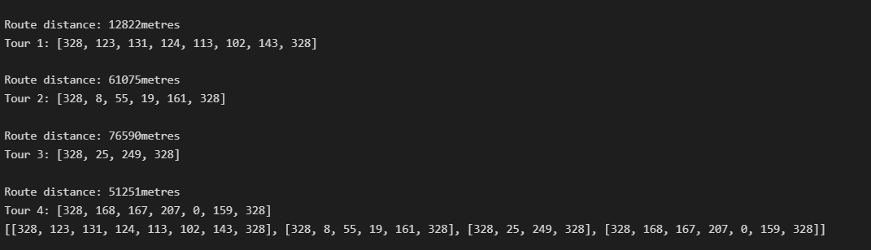
VRP Results
Using the output from the clustering algorithm and running the VRP script gives the following output
The last line of the output will be used to display the routes on the map using the tool that was provided during the project beginning.

Slide 14
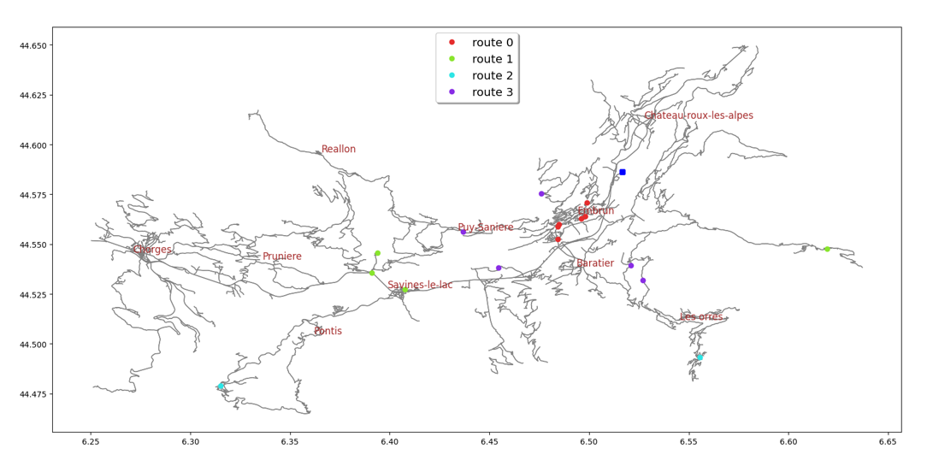
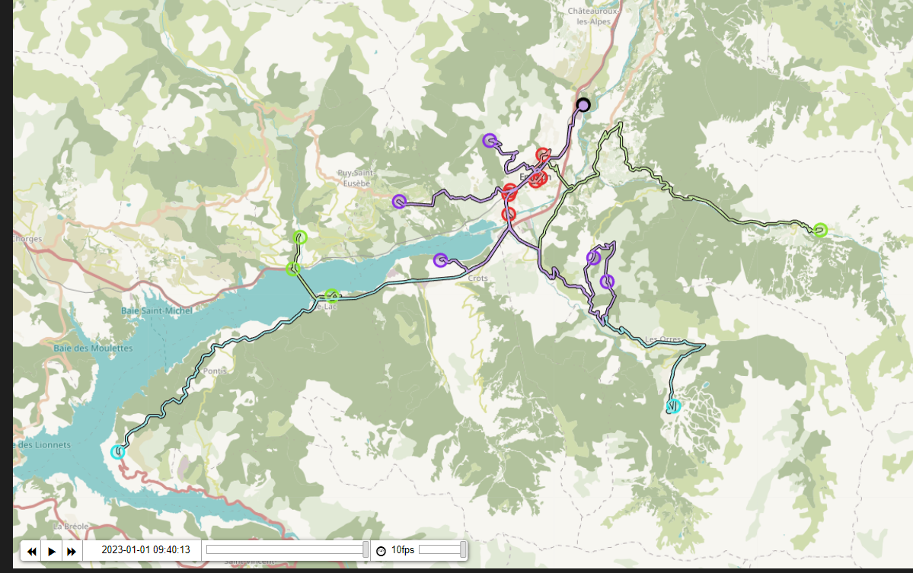
VRP Results
The result of the routing on ‘19-07-2022’ is given below

Slide 15
Conclusion
Analysis of the historical data of the commune was done
Creation of demand forecast was done based on location and types of historical data given
5 forecasting models was used in the study
Selection of model was based on lowest RMSE in each case
K-means clustering model was used to make collection of defined location
Optimized routing locations of each cluster was obtained

Slide 16
Limitations
Inconsistent data which may limit forecast precision
Long run time for the multiple forecasting script as result of the huge numbers in locations
K-means, an unsupervised clustering algorithm was used for the clustering, clusters were primarily based on distance of the location from depot
Optimization of the routes was only for each cluster
Routing was done without considering capacity, number of trucks(Problem here is treated like a TSP)

